Slide 1
Executive Summary

Slide 2

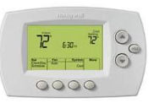
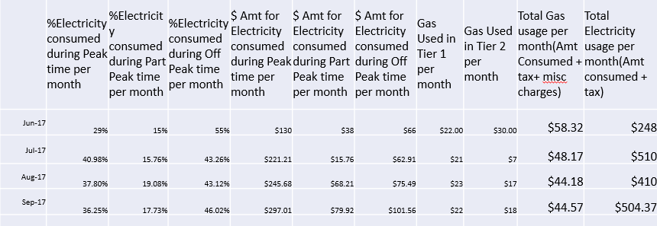
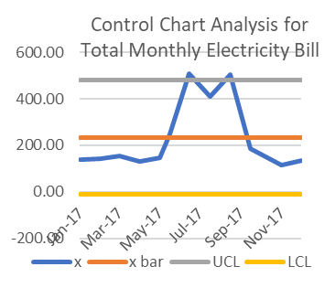

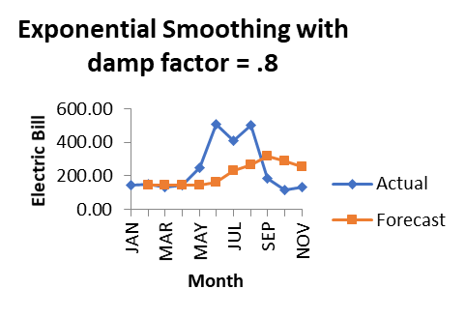


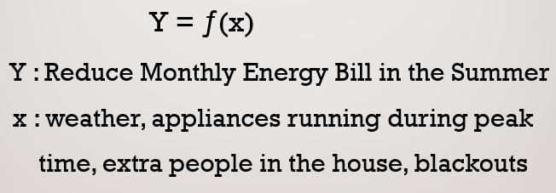
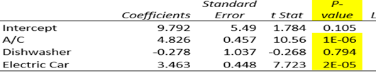
Reduce my Energy Bill for the Summer Months
Process owner: Rebecca Karunakaran
Key Dates --->
Team 7/13
Launch
Define – 7/20
Measure – 7/27
Analyze – 8/10
Improve – 9/7
Control – 9/15
Problem Definition
MEASURE
ANALYZE
IMPROVE
My average energy (electricity and gas) bill is $350 per month except for the summer months of June, July, August and September when the average energy bill shoots to $550 , an increase of $200
Clear indication of signal/problem
Increase the thermostat to cut A/C consumption
Charge the Electric Cars at night instead of during the day
New SQL value 2.2 indicates Process Improvement!
Raw Data indicates Electricity Bill as culprit!
CONTROL
Baseline SQL value 1.5
Time Series shows future electricity bill to be < $300
Multiple Regression says A/C and Electric Cars are main culprits
Goal
Reduce the Electricity bill from $500 to $300.
Maintain the Gas Bill at $50.
TEAM : Myself, my husband and children

Slide 3
Backup Slides

Slide 4
Process improvement Project
Rebecca Karunakaran - MBC 638

Slide 5

DEFINE
Historical energy bills indicate that the average energy bill which included gas and electricity is $350 per month except for the summer months of June, July, August and September when the energy bill can shoots to $550
My goal is to -
- Reduce the Electricity bill from $500 to $300.
- Maintain the Gas Bill at $50.
I will use these goals to measure the success of this project.
I am the Process Owner for this project

Slide 6

DEFINE
Y = ƒ(x)
Y : Reduce Monthly Energy Bill in the Summer
x : weather, appliances running during peak
time, extra people in the house, blackouts

Slide 7

DEFINE
Process Map
Important step - find the list of culprits contributing to my bill
Make a list of major appliances that could be key contributors to this increase
Check to see if they are running during the day which is peak time (charge per unit is higher) compared to evening/night which is not peak time
No
Is AC running?
Yes
Is the dishwasher running during the day (Peak time)?
Appliance contributing to bill, add to list
Appliance not contributing to bill, remove from list
No
Yes
Is the washing machine running the day (Peak time)
No
Yes
No
Yes
Is the electric car charging during the day (Peak)
I now have a list of major appliances contributing to the energy bill
Logon to computer and review monthly energy bill

Slide 8

DEFINE
Calculation for Baseline SQL
Defect opportunities per unit: D =2
Units produced per timeframe: U = 4
Total possible defects per timeframe: D ×U = 8
Total actual defects in timeframe: A = 4
Defect-per-opportunity rate: A ÷DU = DPO =4/8=0.5
Defects per million opportunities (DPMO): DPO ×1,000,000 = .5*1000000=500000
Baseline SQL value =1.5
I have 2 categories that make up the monthly energy bill – Gas and Electricity and hence defect opportunities per unit = 2
Timeframe for my project is 4 months of historic energy bills (June/July/Aug/Sept) and hence unit/timeframe =4

Slide 9

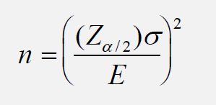
DEFINE
Data Type: The primary source of data for my project was the energy bill statements which is continuous data. In addition, I did have some discrete data like count of blackout days, count of extra people in the house etc.
Data Collection: Since the goal of my project was to reduce the energy bill in the summer months, I decided on collect data from last summer (June/July/Aug/Sept 2017) and the first 3 summer months for this year(June/July/Aug 2017).
Sample Size. My total sample size was 7.
My ideal sample size based on the sample size formula with
95% confidence was 9.
Not having sufficient sample does reduce the accuracy of results
Data Quality: Since most of the data was collected from online historical billing statements, the data is very accurate.

Slide 10

DEFINE
Data Measurement Plan
Performance Measure | Data Source and Location | How will Data be collected | Who will collect Data | When will Data be collected | Target Sample Size
%Electricity consumed during Peak time per month | Online PG&E Month Bill | Check Electricity Usage % section in the bill | Rebecca | 27-Jul | 4 months
%Electricity consumed during Part Peak time per month | Online PG&E Month Bill | Check Electricity Usage % section in the bill | Rebecca | 27-Jul | 4 months
%Electricity consumed during Off Peak time per month | Online PG&E Month Bill | Check Electricity Usage % section in the bill | Rebecca | 27-Jul | 4 months
$ Amt for Electricity consumed during Peak time per month | Online PG&E Month Bill | Check Electricity Usage % section in the bill | Rebecca | 27-Jul | 4 months
$ Amt for Electricity consumed during Part Peak time per month | Online PG&E Month Bill | Check Electricity Usage % section in the bill | Rebecca | 27-Jul | 4 months
$ Amt for Electricity consumed during Off Peak time per month | Online PG&E Month Bill | Check Electricity Usage % section in the bill | Rebecca | 27-Jul | 4 months
%Gas Used in Tier 1 per month | Online PG&E Month Bill | Gas Charges Tier Usage Section | Rebecca | 28-Jul | 4 months
%Gas Used in Tier 2 per month | Online PG&E Month Bill | Gas Charges Tier Usage Section | Rebecca | 28-Jul | 4 months
Total Gas usage per month | Online PG&E Month Bill | Gas Charges Tier Usage Section | Rebecca | 28-Jul | 4 months
Total Electricity usage per month | Online PG&E Month Bill | Account Summary Section | Rebecca | 28-Jul | 4 months
Total Energy Bill per month | Online PG&E Month Bill | Account Summary Section | Rebecca | 28-Jul | 4 months
No of blackouts in the summer month | Personal Calendar | Use data noted Personal Calendar | Rebecca | 29-Jul | 3 months
Loss in dollars due to blackouts | Credit card bill | Pull from online credit card bill | Rebecca | 29-Jul | 3 months
Average temperature outside >70 F | Online PG&E Month Bill | Energy history section | Rebecca | 30-Jul | 4 months
Any extra people/guests in the household | Personal Calendar | Use data noted Personal Calendar | Rebecca | 29-Jul | 4 months
A/C usage | Daily Observation | Daily Observation | Rebecca | 8/15-8/30 | 2 weeks
Dishwasher | Daily Observation | Daily Observation | Rebecca | 8/15-8/30 | 2 weeks
Electric Car | Daily Observation | Daily Observation | Rebecca | 8/15-8/30 | 2 weeks
Data collected was both discrete and continuous

Slide 11

DEFINE
Raw Data
 | %Electricity consumed during Peak time per month | %Electricity consumed during Part Peak time per month | %Electricity consumed during Off Peak time per month | $ Amt for Electricity consumed during Peak time per month | $ Amt for Electricity consumed during Part Peak time per month | $ Amt for Electricity consumed during Off Peak time per month | Gas Used in Tier 1 per month | Gas Used in Tier 2 per month | Total Gas usage per month(Amt Consumed + tax+ misc charges) | Total Electricity usage per month(Amt consumed + tax) | Average temperature | Average temperature outside >70 F | No of blackouts in the summer month | Loss in dollars due to blackouts | Any extra people/guests in the household
Jun-17 | 29% | 15% | 55% | $130 | $38 | $66 | $22.00 | $30.00 | $58.32 | $248 | 68 F | NO | 0 | 0 | No
Jul-17 | 40.98% | 15.76% | 43.26% | $221.21 | $15.76 | $62.91 | $21 | $7 | $48.17 | $510 | 75 F | YES | 0 | 0 | No
Aug-17 | 37.80% | 19.08% | 43.12% | $245.68 | $68.21 | $75.49 | $23 | $17 | $44.18 | $410 | 73 F | YES | 1 | $180 | No
Sep-17 | 36.25% | 17.73% | 46.02% | $297.01 | $79.92 | $101.56 | $22 | $18 | $44.57 | $504.37 | 76 F | YES | 0 | 0 | Yes
Jun-18 | 30.00% | 17% | 52% | $127.00 | $40.00 | $57.00 | $20 | $33 | $60.00 | $237.00 | 66 F | NO | 0 | 0 | No
Jul-18 | 40% | 16% | 43% | $221 | $46 | $62 | $22 | $6 | 30 | $348 | 71 F | YES | 0 | 0 | No
Aug-18 | 41% | 17% | 42% | $315 | $69 | $85 | $23 | $14 | $39 | $495 | 73 F | YES | 0 | $0 | No
My Raw Data indicates the Electricity Bill is the main culprit not the Gas Bill
Appliances-Major/hours | Day1 | Day2 | Day3 | Day4 | Day5 | Day6 | Day7 | Day 8 | Day 9 | Day10 | Day11 | Day12 | Day13 | Day14
A/C in hours | 10 | 11 | 10 | 12 | 8 | 7 | 12 | 14 | 12 | 6 | 5 | 6 | 7 | 6
Dishwasher in hours | 3 | 3 | 3 |  | 3 |  | 3 | 3 | 3 | 1 | 3 | 3 | 0 | 3
Electric Car Charge in hours | 6 | 6 | 0 | 6 | 6 | 8 | 6 | 6 | 0 | 4 | 6 | 0 | 6 | 10
Energy Used in kWh | 72 | 78 | 61 | 86 | 76 | 74 | 91 | 96 | 70 | 48 | 55 | 33 | 67 | 72

Slide 12

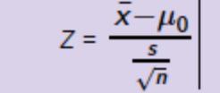
DEFINE
Hypothesis Test
The average energy bill during the 4 summer months in 2017 was $460.
My hypothesis – is there evidence that the average energy bill for the summer this year will be > $450
Ho: <= 450 Ha: µ > 450
Assumed standard deviation is $30 and alpha is 0.05. Sample size n is 4
Since my data Continuous and is a one-sample data, I will use the Purple chart.
My hypothesis is a One tailed and Right tail.
I used the Z test since I know sigma z= .06
ƿ=1-(NORM.S.DIST(z, TRUE)) = 0.3
if ƿ < = α, Ho must go. Since .03 < .05, Ho must go.
My hypothesis test shows that the average energy bill for the summer this year will be greater than $450
I used the Hypothesis Test to see if my Energy Bill will go up this year

Slide 13

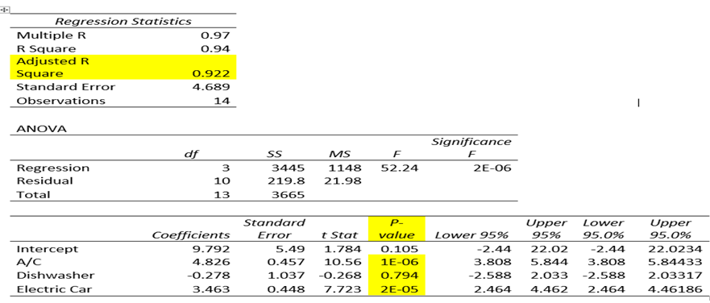
Since my Hypothesis testing has indicated that my Energy Bill will go up this year, I decided to use Multiple Regression to see which appliance has the greatest influence on on the Electricity Bill.
P – values indicate that the A/C and the Electric Car contribute the most to the Electricity Consumption
 |  | total hours -Major Appliance
 | x1 | x2 | x3 | y
Sample | A/C | Dishwasher | Electric Car | kWh
Day1 | 10 | 3 | 6 | 72
Day2 | 11 | 3 | 6 | 78
Day3 | 10 | 3 | 0 | 61
Day4 | 12 | 0 | 6 | 86
Day5 | 8 | 3 | 6 | 76
Day6 | 7 | 0 | 8 | 74
Day7 | 12 | 3 | 6 | 91
Day8 | 14 | 3 | 6 | 96
Day9 | 12 | 3 | 0 | 70
Day10 | 6 | 1 | 4 | 48
Day11 | 5 | 3 | 6 | 55
Day12 | 6 | 3 | 0 | 33
Day13 | 7 | 0 | 6 | 67
Day14 | 6 | 3 | 10 | 72

Slide 14

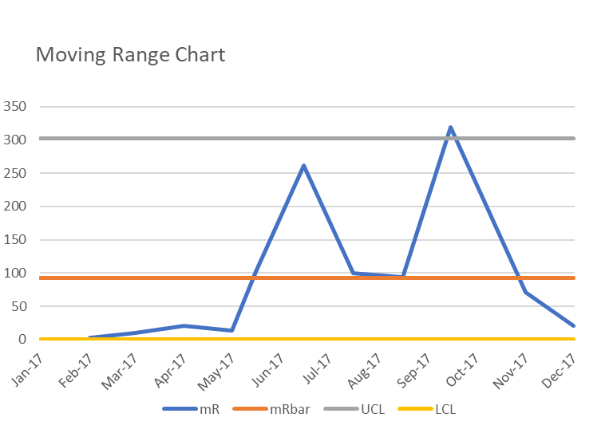
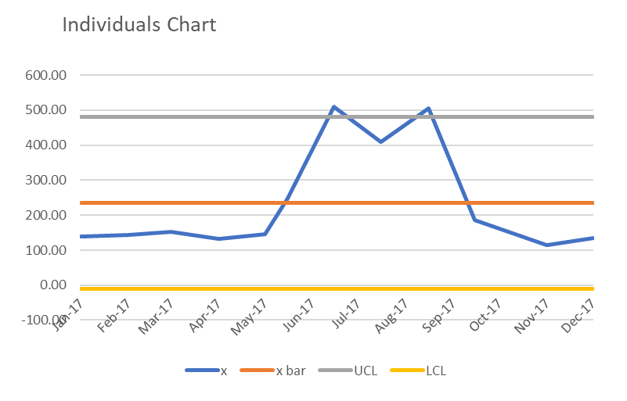
Control Chart Analysis for Total Monthly Electricity Bill
Clear indication of
Clear indication of Signals/ Problems

Slide 15

DEFINE
The Control Chart has clearly indicated a Spike in the Monthly Electricity Bill during June/July/Aug/Sept
Here are a few improvements that I have decided to implement to tackle this problem
1. Since my analysis indicated that the A/C was one of the main culprit, I will adjust the Thermostat and set it to 80 degrees F instead of 76 degrees F. This in turn should cut down the number of hours the A/C runs which should reduce the electricity consumption
2. The other culprit indicated by my analysis is the Electric Car. I will start charging my 2 electric cars at night instead of during the day when the electricity charge is much lower (off peak).

Slide 16

DEFINE
New Sigma Quality Level SQL
If I had implement the improvements identified the New SQL level based on estimated energy bill is -
Defect opportunities per unit: D =2
Units produced per timeframe: U = 4
Total possible defects per timeframe: D ×U = 8
Total actual defects in timeframe: A = 2
Defect-per-opportunity rate: A ÷DU = DPO =2/8=0.25
Defects per million opportunities (DPMO): DPO ×1,000,000=.25*1000000=250000
SQL value (from SQL table) =2.2
SQL has increased from baseline value of 1.5 to 2.2 which indicates improvement

Slide 17
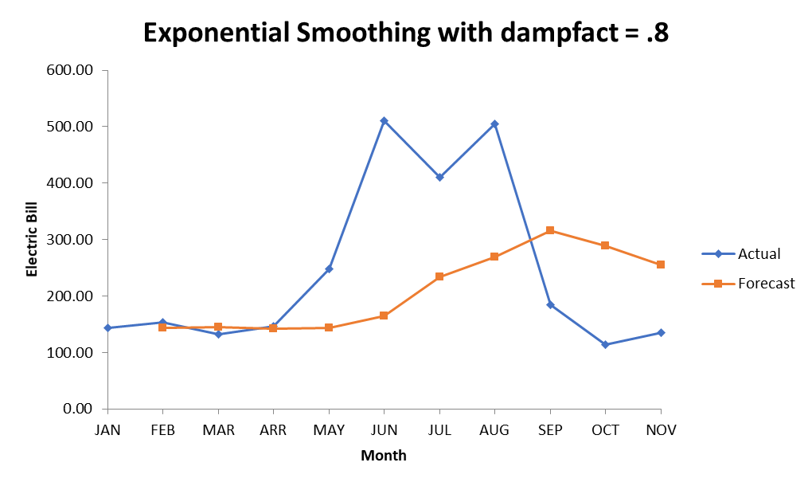
DEFINE
Time Series to project future Electricity Bills
Using the Time Series I
can see my projected electricity
bill to be around $300 or less
even for the summer months
which is exactly what I had
hoped to accomplish with
this project!

